Slide 1
BEHAVIOR THERAPY NEW DIMENSIONS

Slide 2
Behavior therapy was defined as the application of modern learning theory to the treatment of clinical problems where behavior was regarded as a function of its consequences.

Slide 3
Gradually it came to be recognized that the influence of environmental events on behavior is largely determined by cognitive processes which govern what environmental influences are attended to, how they are perceived and how the individual interprets them.

Slide 4
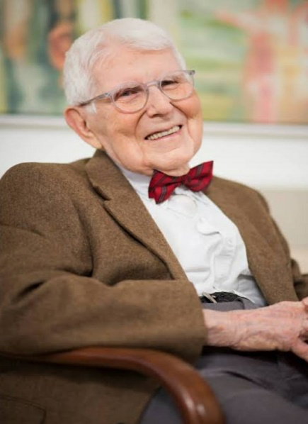
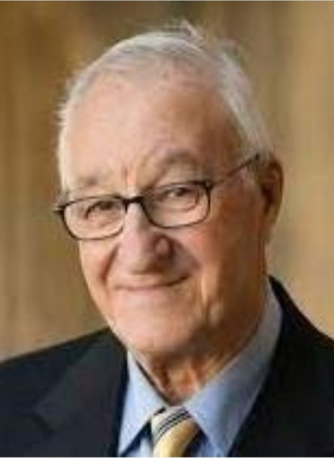
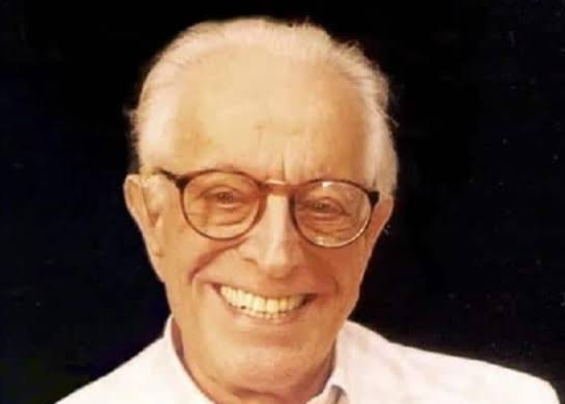
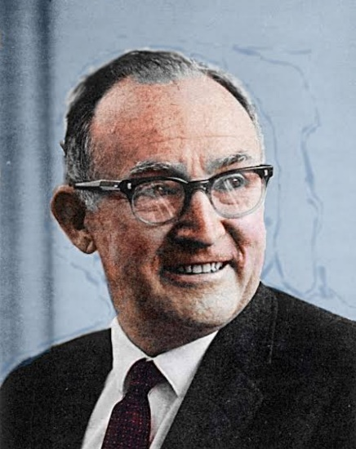
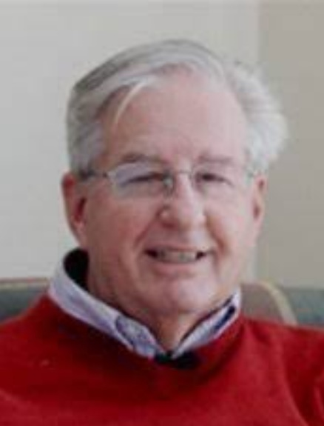
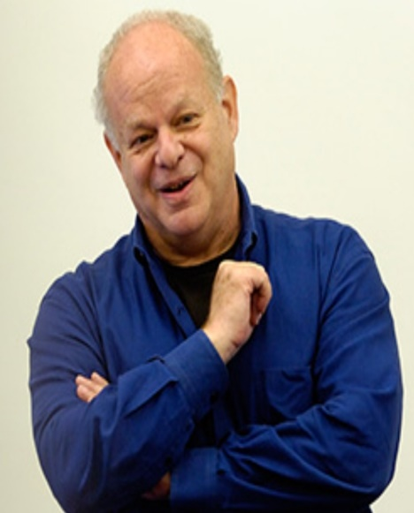
AARON BECK
ALBERT BANDURA
ALBERT ELLIS
MARTIN SELIGMAN
MARTIN MICHEINBAUM
GEORGE KELLY

Slide 5
GOAL OF COGNITIVE BEHAVIOR THERAPY
Understand the subjective interpretation or judgment of the experience of the individual.
Assist him to interpret in a more realistic and adaptive manner.

Slide 6
BASIC ASSUMPTIONS IN COGNITIVE BEHAVIOR THERAPY
The way individuals interpret events and situations mediate how they subsequently feel and behave.

Slide 7
The interpretation of events is active and ongoing. Individual establishes a “personal environment” and accordingly respond to events.

Slide 8
Individuals develop idiosyncratic belief systems that guide behavior, influencing an individual’s perception and memories and leading to memories being activated by specific stimuli or events called “stressors”.

Slide 9
These stressors consequently contribute to a functional impairment of an individual’s cognitive processing and activate maladaptive overlearned coping responses.

Slide 10
The cognitive specificity hypothesis states that clinical syndromes and emotional states can be distinguished by the specific content of the belief system and the cognitive process that are activated.

Slide 11
CASE STUDY
Case A
Ph.D scholar in IIT, Kharagpur
Symptoms: Anxiety especially before exams.
Palpitations, shivering of hands, lack of appetite, headache, lips twitch.
Crying spells, afraid to go out, feels she will die, seeks reassurance.
Is in a dilemma: whether to continue research or to take a job and buy a 1bhk flat which will give her some self worth.
Uncongenial home environment

Slide 12
What are the situations which make you feel so negative? What are your thoughts in those situations?
Birthday : I don’t deserve.
Friend’s gift : Not doing from heart. I am not that worth.
Boyfriend friendly with another girl : I am not enough.
After talking with friends : Maybe I spoke too much. Maybe I overshared.

Slide 13
Self Idea: I am not that worth.
Idea of others: Others do not like me.

Slide 14
You feel others do not like you. Did you hear negative remarks from others? How early you can think of?
She narrated interesting news: no one believed
Told about earthquake: no one believed
In madhyamik got 92%: sarcasm
Mother can now stand with her head held high
She sat behind the 1st. girl in exams, results very good, cheated
Teacher’s day, suggestion of gift: no one accepted
Secret leaked: blame on her
Tutor: very disobedient
Peer group: Negative remarks
Told friends after getting in IIT: Anybody can get.
Boyfriend hurtful: I am not good enough
Art teacher: If you want to be art director then you have to learn art.
Chemistry teacher: You are a good student?
IIT Senior: Will you be able to do it?

Slide 15
What thoughts make you so anxious before exams?
I will not perform well.
If it happens why will it be so upsetting?
I will fall behind.
Suppose it is true why will that be so upsetting?
Others will think I am no good.
Suppose they think like that what would be so upsetting for you?
Then I am not good.

Slide 16
SCHEMA
Self Schema I am no good/of no worth/importance
Schema of self in relation to others: Others think less of me.
Schema of good and bad: A person is good if others approve of me.

Slide 17
SCHEMA & AUTOMATIC THOUGHTS
Schema refers to organized cognitive structures made up of general knowledge about the attributes of a stimulus domain and the relationships among these attributes.
Automatic thoughts are thoughts that automatically come into the mind.

Slide 18
SCHEMA - CHARACTERISTICS
Give meaning to incoming information.
Not in conscious awareness but directs our attention.
Incorporate emotions.
Maintained through process of assimilation and accomodation.
Developed and consolidated over the course of an individual’s infancy and childhood.
Activated by experiences that are similar to early experiences.
Activation spreads through associative links of the schema’s network.

Slide 19
COGNITIVE DISTORTIONS
LABELING
SELECTIVE ABSTRACTION
PERSONALIZATION
FORTUNE TELLING
MIND READING
JUMPING TO CONCLUSION

Slide 20
PRESENT STRESSORS
Viva: Cannot answer a question.
I am no good and I will not be able to perform.
Project Leader: “we will manage. You can do other things.”
I am not wanted.
Classmate’s comment: But she didn’t do well in HS.
I am still as bad as I was before. I couldn’t come up.
When her research guide attends to another research scholar.
He gets more attention. He is superior.

Slide 21
MALADAPTIVE COPING MECHANISMS USED
Others will love me…….if
If I perform very well in academics.
Hard work may not be sustained, will generate lot of anxieties.
Stressor: Low result, someone doing better, criticism
If I have very close friends.
Excess socialization at the cost of other things, a pressure to be good to people, difficulty to say no, fear of rejection
Stressor: loss of friendship, criticism
If I am given responsibilities.
Lot of extra work
Stressor: Not given responsibility while others are given.

Slide 22
COGNITIVE RESTRUCTURING
Questioning the evidence:
Did her M.Sc. 1st. Sem. with severe depression yet performed very well.
Though overwhelming at first yet is able to master. Eg. Cycling, literature survey
Did M.Sc. from IIT (K) and at present doing Ph.D.
She went to collect her luggage alone.
Patience
Takes up negative comments as challenge
Can organize events.
Cooks well.

Slide 23
COGNITIVE RESTRUCTURING
Rational Responding
Challenging dysfunctional thought
Identification of thought, emotion and situation which is causing difficulty and then developing a rational response.
Questions asked:
What is the evidence for and against the specific interpretation?
Are the interpretations logical?
Is the causal relationship correct?
Is a thought confused with a fact?
Are interpretations of the situation realistic?
Is it black and white thinking?
Are you confusing certainties with possibilities?
What are the advantages and disadvantages of this type of thinking?
What would be a more rational way of looking at that?

Slide 24
Other cognitive techniques used:
Decatastrophizing, distraction, labeling of distortion
Behavioral techniques used:
Activity scheduling, relaxation techniques

Slide 25
NEW SCHEMA
I am adequately capable by my own behavior and my own performance.
It is nice when people appreciate me. But always people may not validate me.
I must be able to evaluate myself and also appreciate myself.

Slide 26
CASE B
Male, studying in 1st year of college with Eng. hons. Only child living with parents and grandmother.
He sees smashed faces of his parents and grandmother as images. He has to stop what he is doing, imagine another person’s face there and in this way “reverse” the harm that may happen to his close people. He was diagnosed with OCD.
Separation anxiety & other fears in childhood.
Childish, no ambition, wants to do something small and stay with parents.

Slide 27
SCHEMA
Adulthood is fearful. One loses one’s parents and becomes alone.
Psychologically trying to halt his development.
Behaviorally childish for his age.
FEAR: Fear of losing close people, fear of being alone.
Self Schema: I am less.
I lack in capacity
It is alright if I do something small.
STRESSOR: Criticism, Comparison

Slide 28
INTERVENTIONS
Psychoeducation
Psychoanalytic Theory of Personality
Carter & McGoldrick’s 6 stages of Family Life Cycle

Slide 29
CHALLANGING THE FAULTY INTERPRETATION
Challenging the overimportance given to thought.
Challenging thought can cause action.
Challenging the need to control thought.
Challenging threat estimation.

Slide 30
EXPOSURE BASED TECHNIQUES
Systematic desensitization
Flooding
QUESTIONING THE EVIDENCE
DISTRACTION

Slide 31
MALADAPTIVE SCHEMA
People will die and leave you, you are alone and helpless.
I lack in capacity.
If I do not grow up, I can be with my parents and they will not have much demands or expectations from me.

Slide 32
REALISTIC SCHEMA
My parents are well. We enjoy each other’s company.
If anyone gets sick, Doctor will help and medical science has made great advancement.
“Reverse” will not help.
I can do things when needed, what is of interest to me.
I don’t have to be like somebody else.
It is okay to be myself.

Slide 33
Also learnt to distinguish between relevant and irrelevant thoughts.
Irrelevant = I don’t need to act. I can ignore.
Previous Error: I was trying to control them so that they do not come because I believed in them & I was afraid of them.

Slide 34
PRESENT STATUS
Passed B.A with 71%.
Applying for bank jobs. Taking tuitions.
Planning to stay in Kolkata with his cousin.
Made plans for future:
Plan A: To get a job & do Ph.D. in distance.
Plan B: M.A. & Ph.D. go for academics.

